Slide 1
CS 4530 & CS 5500
Software Engineering
Lesson 12.4: Measuring Engineering Productivity
Jonathan Bell, John Boyland, Mitch Wand
Khoury College of Computer Sciences © 2021, released under CC BY-SA

Slide 2
Learning Objectives for this Lesson
By the end of this lesson, you should be able to…
Apply a goal/signal/metrics framework in software engineering as a feedback loop to improve processes

Slide 3
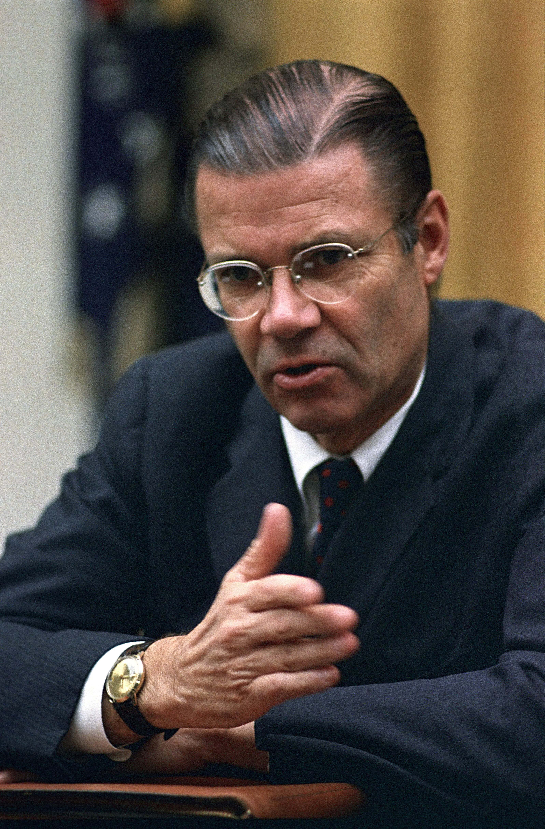
McNamara Fallacy
Reminder (See Lesson 12.2)
Measure whatever can be easily measured
Disregard that which cannot be measured easily
Presume that which cannot be measured easily is not important
Presume that which cannot be measured easily does not exist
Notes:
Robert McNamara was secdef in the 60’s, had previously been an executive at Ford where he made quantitative metrics for each phase of production and ruthlessly optimized to improve efficiency and production. Applied similar strategy to secdef… “Things you can count, you ought to count - loss of life is one” - so, based lots of strategy on body counts. Body count is one thing, but not the whole picture. After war ended in interviews, generals commented that body counts were misguided way to measure progress. Compare to: using LoC to track progress on a project… how do you even know how many lines there should be, and is it good to have a lot? Software metrics are very tricky because it it is hard to quantify everything.

Slide 4
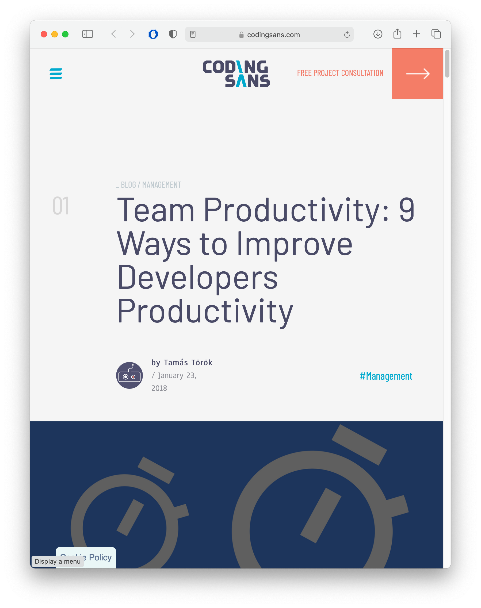




https://codingsans.com/blog/team-productivity-improve-developers-productivity
https://intuitusadvisory.com/insights/7-killers-of-software-development-productivity-and-how-they-impact-value
Notes:
The problem with this fallacy is: how do we measure improvement? There are many a researcher, consultant, engineer, or snake oil salesman out there offering an approach to improve your software development productivity. (Click) Remember that this has been the goal of software engineering all along - since the 1969 NATO report that described the software crisis. So: how do we make an informed business case of whether we should change a process or not?

Slide 5
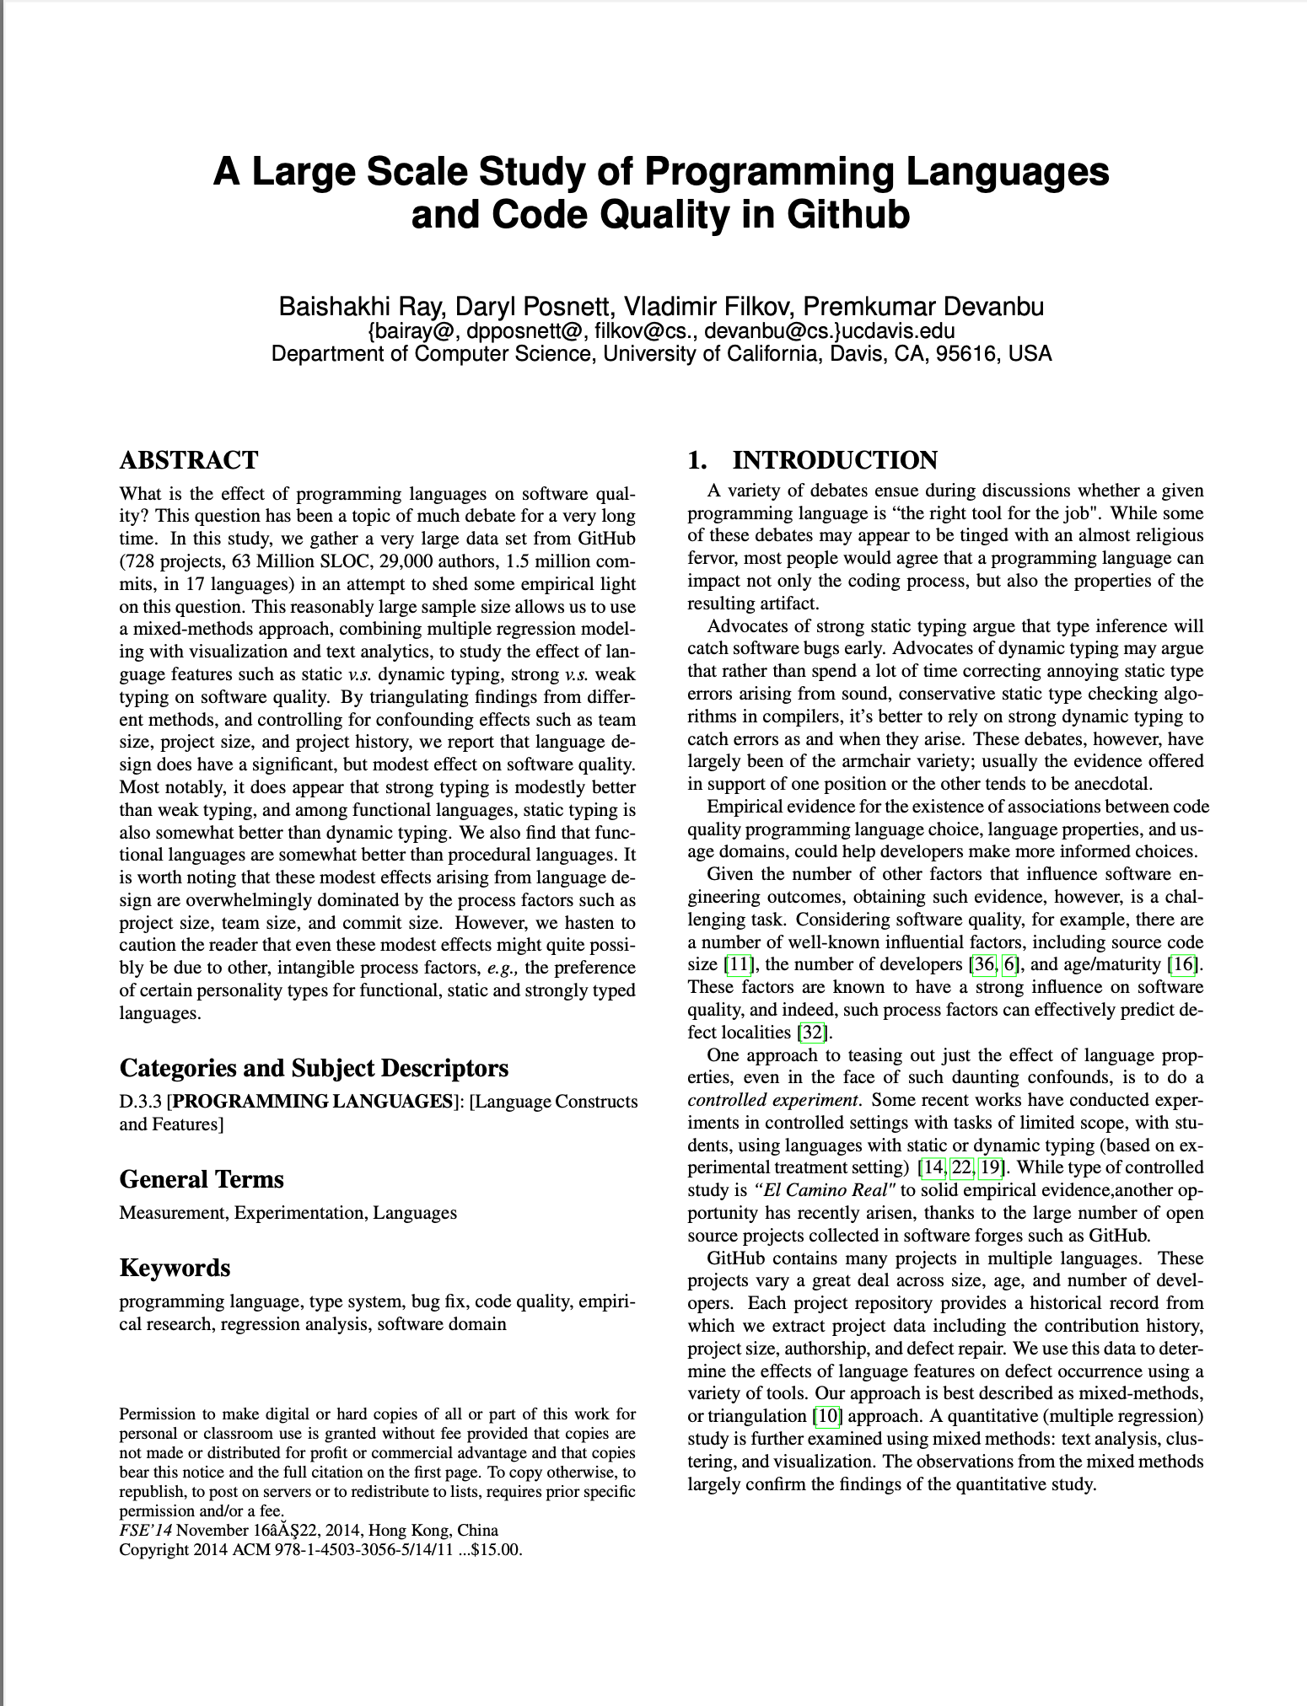
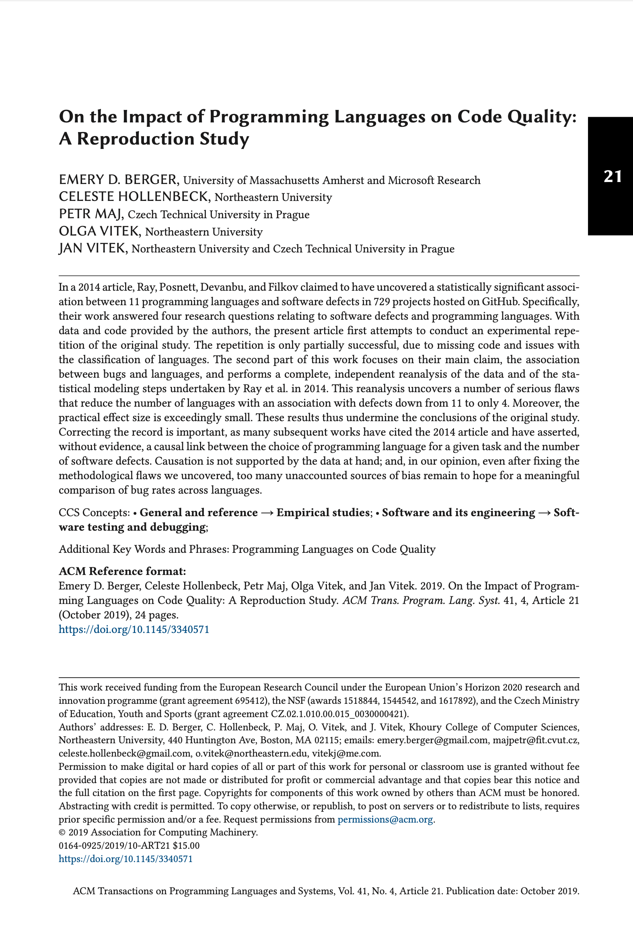
Notes:
One overall approach common in research is to study different open source projects. For instance: we might study lots of open source projects on GitHub, and try to identify if projects written in particular languages were more prone to defects than others. We are limited to only draw conclusions based on the metric studied (in this case - defect density), and will be oblivious to other productivity issues (is it harder to write code in some language than some other? Is it harder to maintain it?). Moreover, there can be an enormous number of confounding variables that are difficult to pin down, and recent work has demonstrated that it is unlikely that we can draw any meaningful comparison of metrics like defect rates across languages.

Slide 6
Metrics and Productivity
Applying metrics, sanely
Consider multiple quantitative and qualitative metrics
Use metrics to evaluate performance in aggregate, and not for an individual’s performance review
Notes:
Easy to measure the wrong thing with quantitative metrics. If do both quantitative metrics (like LoC per hour) and qualitative metrics (like self-reported productivity), can identify discrepencies. As discussed in lesson 12.2, Goodhart’s Law reminds us that once you start measuring something, the subject that you’re measuring might change behavior - like the developer who gets paid per bug fixed being incentivized to make buggy code. We can avoid this risk if we don’t create any incentives for the people we are measuring to change their behavior.

Slide 7
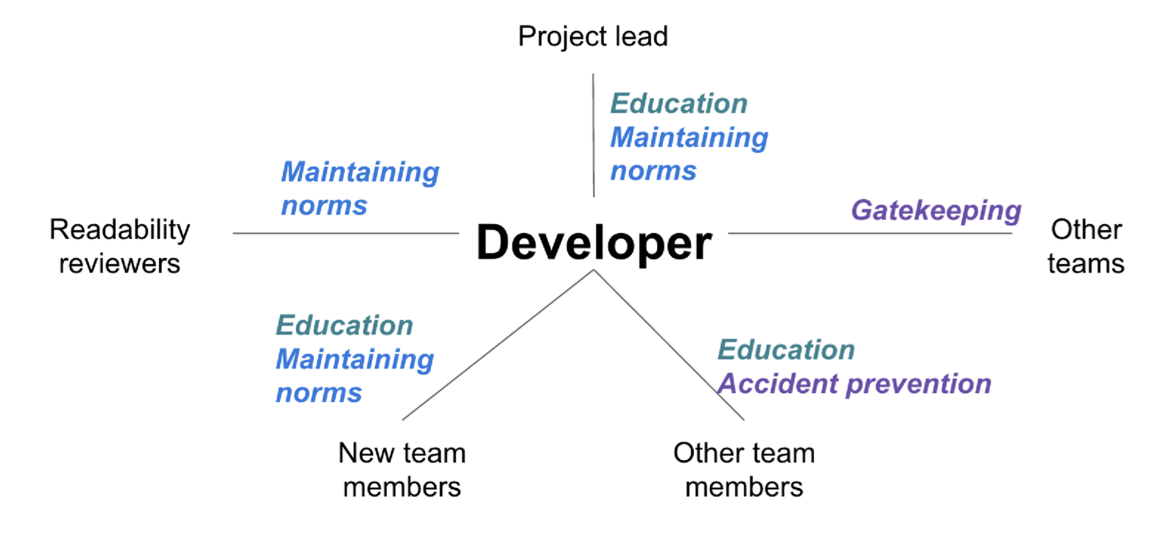

Measuring and Improving Engineering Productivity
Example: Code Review Processes
You need to have 100’s of successful changes integrated before you can be a readability reviewer
Is this hazing?
Do linters replace this?
“Modern Code Review: A Case Study at Google”, Sadowski et al, ICSE 2018
Notes:
Note - this is a large scale process example. Can apply the same process that we will discuss next to much smaller processes too, but nice to see on a big example. What’s particularly interesting about this example is that it’s unclear what metrics we would measure. Ultimately, we want to know: does readability increase or decrease productivity?

Slide 8
How do we measure process efficiency?
Goal/Signal/Metric framework
Goal: desired end result
Signal: How we’re likely to know if we’ve achieved the end result, may not be measurable
Metric: A proxy for a signal, which can actually be measured
[Software Engineering @ Google Ch 7]
Notes:
Goal is high level, does not reference what we want to measure. Signals are what we wish we could measure, but maybe can’t at scale, metrics capture what we can measure quantitatively. By creating goals, then signals, then metrics (and then running an experiment), we avoid streetlight effect - of only looking at what we can easily see, and not looking in the right place. Pre-determining metrics in advance improves validity of final conclusion - avoid stakeholders proposing “alternate” metrics that have different results than the metrics that make the most sense. Not all signals may be measurable, and that’s important to understand.

Slide 9
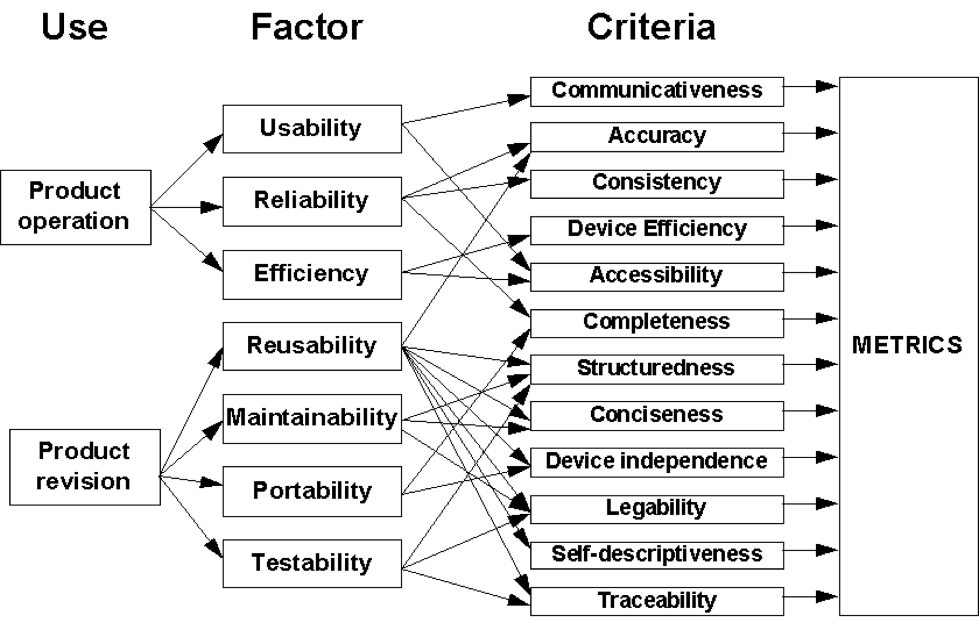
From Quality Goals to Metrics
McCall Quality Model
“A Framework for the Measurement of Software Quality”, Cavano & McCall
Notes:
To identify potential signals and metrics, we can use a common model. The McCall quality model, for instance, starts with high level use cases (like the user-facing aspects of product operation or the developer-facing aspects of product revision and maintenance), and then expanding to the quality factors that we are interested in, and then mapping those quality factors to criteria - like from maintenance to testability to legibility.

Slide 10
From Quality Goals to Metrics
McCall Quality Model
Closure time
Isolate/fix time
Fault rate
Statement coverage
Test plan completeness
Resource prediction
Effort expenditure
Change effort
Change size
Change rate
Faults count
Correctability
Degree of testing
Maintainability
Testability
Expandability
Effort
Change counts
Notes:
Then, once we’ve considered those quality factors, we can drill down to common metrics: like if we are interested in correctability - the ability to fix bugs, we might want to measure metrics both related to the number of faults (like how long it takes to isolate/fix them, how long it takes to close the issue and validate the fix, how often those faults occur) and also those related to the developer’s effort - how much time is estimated by the developer to correct each of these faults, and how long it actually took.

Slide 11
Engineering Productivity: A Broad Goal
QUANTS components
Quality of the code (Is it tested? Is it maintainable?)
Attention from engineers (Does the process distract engineers?)
Intellectual complexity (How does the complexity of the process relate to the complexity of the task?)
Tempo and velocity (How quickly can engineers accomplish their tasks?)
Satisfaction (How happy are engineers?)
[Software Engineering @ Google Ch 7]
Notes:
There are quite a few quality factors that we might track - how do we define a goal of engineering productivity, for example, in the context of determining what to do with readability reviews? One easy way to make code reviews faster, aside from removing readability review is to simply remove all code review: now our development velocity is faster. It’s important to consider trade-offs in productivity. The “QUANTS” factors are commonly-analyzed goals to breakdown productivity into multiple factors.
For readability review: Quality is a goal for readability, attention is not, intellectual complexity (engineers learn about best practices and receiving mentoring as part of readability), tempo (engineers complete work faster and more efficiently), satisfaction (engineers see a benefit in the readability process)

Slide 12
From Goals to Signals and Metrics
Readability Review
Goal: “Engineers write higher-quality code as a result of the readability process.”
Signal: “Engineers who have been granted readability judge their code to be of higher quality than engineers who have not been granted readability.”
Metric: “Quarterly Survey: Proportion of engineers who report being satisfied with the quality of their own code”
Signal: “The readability process has a positive impact on code quality.”
Metric: “Readability Survey: Proportion of engineers reporting that readability reviews have no impact or negative impact on code quality”
Metric: “Readability Survey: Proportion of engineers reporting that participating in the readability process has improved code quality for their team”
[Software Engineering @ Google Ch 7]
Notes:
Some goals might have multiple signals - like to measure that engineers complete tasks faster and more efficiently as a result of readability, you need to study both populations - those who have been given this readability status ,and those that haven’t. These might lead themselves to easy metrics - like surveys of engineers, log data from reviewing processes. There are both qualitative and quantitative metrics. Others might not have good metrics: tracking code quality is difficult, this is just looking at self-reported perceived quality.

Slide 13
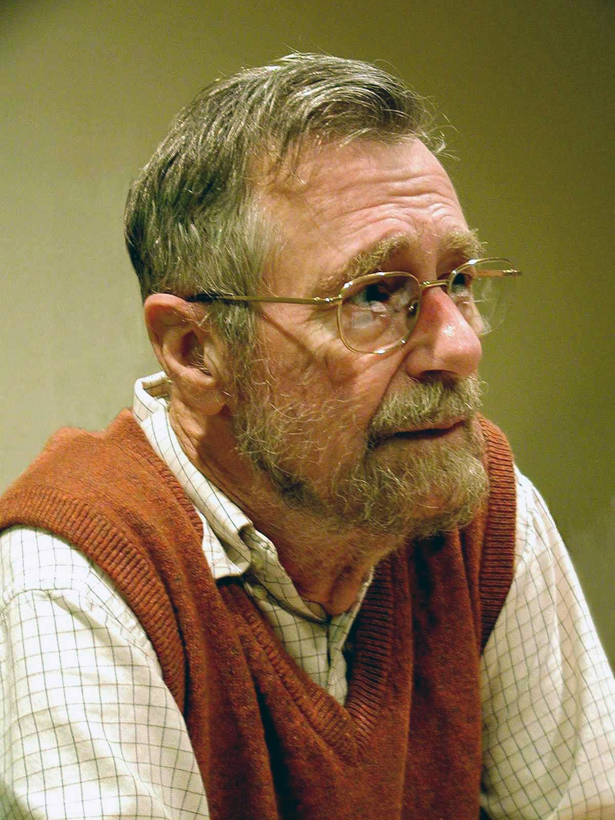
A closing word on productivity
“On the cruelty of really teaching computing science”
From there it is only a small step to measuring ‘programmer productivity’ in terms of ‘number of lines of code produced per month.’ This is a very costly measuring unit because it encourages the writing of insipid code, but today I am less interested in how foolish a unit it is from even a pure business point of view. My point today is that, if we wish to count lines of code, we should not regard them as ‘lines produced’ but as ‘lines spent’: the current conventional wisdom is so foolish as to book that count on the wrong side of the ledger.
- Edsger W. Dijkstra
Notes:
Dijkstra reminds us that aside from how foolish it is to count lines of code as a unit of value (because it encourages programmers to write terrible code that is unnecessarily long), there is an argument that each line of code that you write is a debt that you take on - to maintain that line of code. Hopefully throughout this course you’ve learned a variety of techniques to write software that will be of higher quality - not only doing the right thing, but also software that is maintainable, and won’t become a nightmare for the software engineer who steps in after you.

Slide 14
This work is licensed under a Creative Commons Attribution-ShareAlike license
This work is licensed under the Creative Commons Attribution-ShareAlike 4.0 International License. To view a copy of this license, visit http://creativecommons.org/licenses/by-sa/4.0/
You are free to:
Share — copy and redistribute the material in any medium or format
Adapt — remix, transform, and build upon the material
for any purpose, even commercially.
Under the following terms:
Attribution — You must give appropriate credit, provide a link to the license, and indicate if changes were made. You may do so in any reasonable manner, but not in any way that suggests the licensor endorses you or your use.
ShareAlike — If you remix, transform, or build upon the material, you must distribute your contributions under the same license as the original.
No additional restrictions — You may not apply legal terms or technological measures that legally restrict others from doing anything the license permits.

